Slide 1
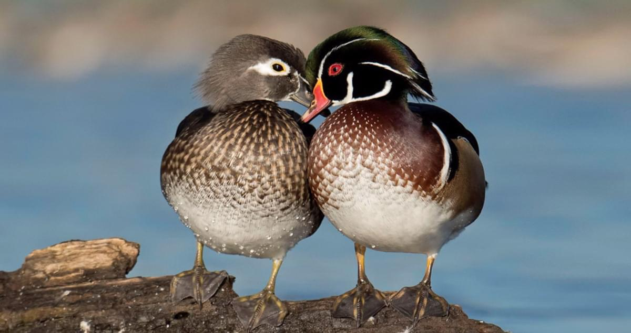
Nest temperature, incubation period, and investment decisions of incubating wood ducks Aix sponsa
R. Hepp, G., T. Hayes Folk, and C. A. Manlove. 2005. Nest temperature, incubation period, and investment decisions of incubating wood ducks Aix sponsa. Journal of Avian Biology 36:523–530.
By: Alexis LaFever, Nick Moses, Kevin Henry, and Will Parker
What factors have the greatest effect on wood duck incubation time?

Slide 2
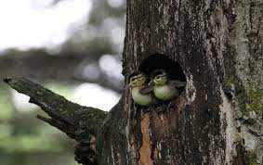
Response variable and predictors
Response variable
Incubation period
Predictors
SD clutch temperature
SD nest temperature
Clutch size
Mean nest temperature

Slide 3
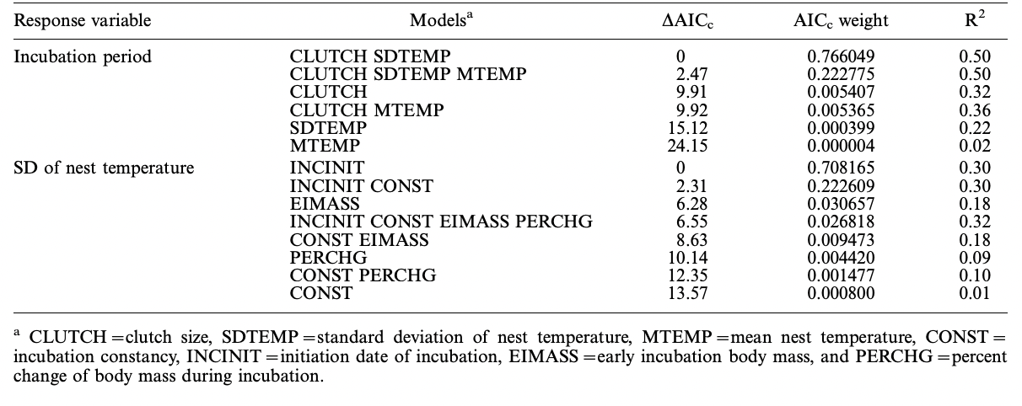
AIC Table

Slide 4

Important Models
The model with the lowest 𝚫AIC is the model with Standard Deviation in temperature and clutch size as the predictor variables
No other model with incubation period as a response variable had a low enough 𝚫AIC (<2.00) to be competitive

Slide 5
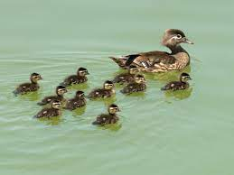
In Conclusion
The model that included clutch size and standard deviation of nest temperature best explained the variation in incubation period of A. sponsa

